Slide 1
Design Patterns
Slides by Libo Feng
Yunnan University

Slide 2
Abstract Factory
Abstract Factory is a creational design pattern that lets you produce families of related objects without specifying their concrete classes.

Slide 3
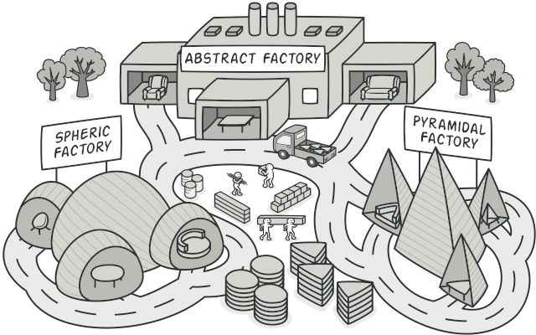
Abstract Factory

Slide 4
Problem
Imagine that you’re creating a furniture shop simulator. Your code consists of classes that represent:
A family of related products, say: Chair + Sofa + CoffeeTable.
Several variants of this family. For example, products Chair + Sofa + CoffeeTable are available in these variants: Modern, Victorian, ArtDeco.

Slide 5
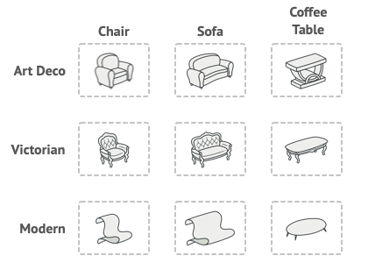
Abstract Factory
Product families and their variants.

Slide 6
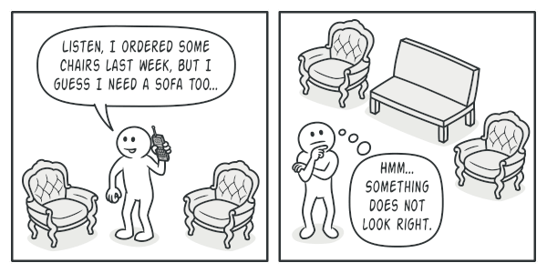
Problem
You need a way to create individual furniture objects so that they match other objects of the same family. Customers get quite mad when they receive non-matching furniture.
A Modern-style sofa doesn’t match Victorian-style chairs.

Slide 7
Problem
Also, you don’t want to change existing code when adding new products or families of products to the program. Furniture vendors update their catalogs very often, and you wouldn’t want to change the core code each time it happens.

Slide 8
Solution
The first thing the Abstract Factory pattern suggests is to explicitly declare interfaces for each distinct product of the product family (e.g., chair, sofa or coffee table). Then you can make all variants of products follow those interfaces. For example, all chair variants can implement the Chair interface; all coffee table variants can implement the CoffeeTable interface, and so on.

Slide 9
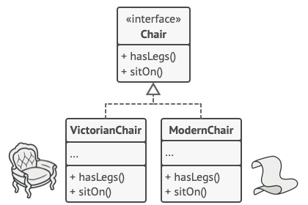
Solution
All variants of the same object must be moved to a single class hierarchy.

Slide 10
Solution
The next move is to declare the Abstract Factory—an interface with a list of creation methods for all products that are part of the product family (for example, createChair, createSofa and createCoffeeTable). These methods must return abstract product types represented by the interfaces we extracted previously: Chair, Sofa, CoffeeTable and so on.

Slide 11
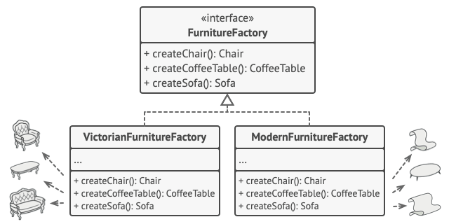
Solution
Each concrete factory corresponds to a specific product variant.

Slide 12
Solution
Now, how about the product variants? For each variant of a product family, we create a separate factory class based on the AbstractFactory interface. A factory is a class that returns products of a particular kind. For example, the ModernFurnitureFactory can only create ModernChair, ModernSofa and ModernCoffeeTable objects.

Slide 13
Solution
The client code has to work with both factories and products via their respective abstract interfaces. This lets you change the type of a factory that you pass to the client code, as well as the product variant that the client code receives, without breaking the actual client code.

Slide 14
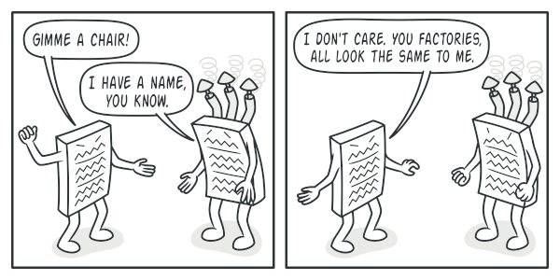
Solution
The client shouldn’t care about the concrete class of the factory it works with.

Slide 15
Solution
Say the client wants a factory to produce a chair. The client doesn’t have to be aware of the factory’s class, nor does it matter what kind of chair it gets. Whether it’s a Modern model or a Victorian-style chair, the client must treat all chairs in the same manner, using the abstract Chair interface. With this approach, the only thing that the client knows about the chair is that it implements the sitOn method in some way. Also, whichever variant of the chair is returned, it’ll always match the type of sofa or coffee table produced by the same factory object.

Slide 16
Solution
There’s one more thing left to clarify: if the client is only exposed to the abstract interfaces, what creates the actual factory objects? Usually, the application creates a concrete factory object at the initialization stage. Just before that, the app must select the factory type depending on the configuration or the environment settings.

Slide 17
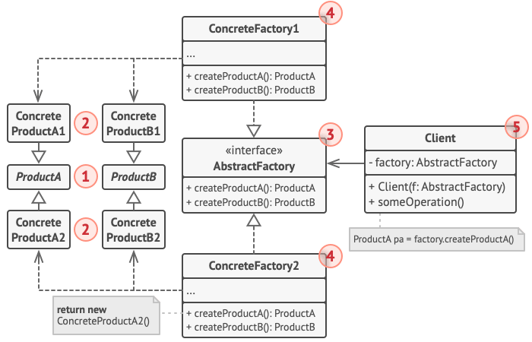
Structure（1）

Slide 18
Structure（2）
Abstract Products declare interfaces for a set of distinct but related products which make up a product family.
Concrete Products are various implementations of abstract products, grouped by variants. Each abstract product (chair/sofa) must be implemented in all given variants (Victorian/Modern).
The Abstract Factory interface declares a set of methods for creating each of the abstract products.

Slide 19
Structure（3）
Concrete Factories implement creation methods of the abstract factory. Each concrete factory corresponds to a specific variant of products and creates only those product variants.
Although concrete factories instantiate concrete products, signatures of their creation methods must return corresponding abstract products. This way the client code that uses a factory doesn’t get coupled to the specific variant of the product it gets from a factory. The Client can work with any concrete factory/product variant, as long as it communicates with their objects via abstract interfaces.

Slide 20
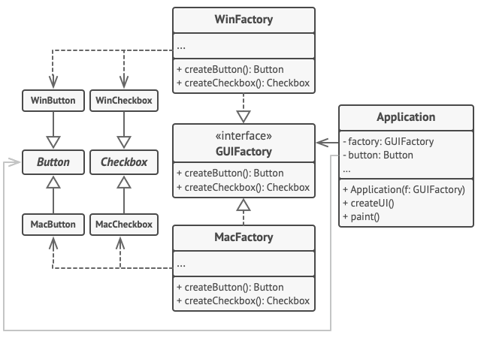
Pseudocode
This example illustrates how the Abstract Factory pattern can be used for creating cross-platform UI elements without coupling the client code to concrete UI classes, while keeping all created elements consistent with a selected operating system.
The cross-platform UI classes example.

Slide 21
Pseudocode
The same UI elements in a cross-platform application are expected to behave similarly, but look a little bit different under different operating systems. Moreover, it’s your job to make sure that the UI elements match the style of the current operating system. You wouldn’t want your program to render macOS controls when it’s executed in Windows.
The Abstract Factory interface declares a set of creation methods that the client code can use to produce different types of UI elements. Concrete factories correspond to specific operating systems and create the UI elements that match that particular OS.

Slide 22
Pseudocode
It works like this: when an application launches, it checks the type of the current operating system. The app uses this information to create a factory object from a class that matches the operating system. The rest of the code uses this factory to create UI elements. This prevents the wrong elements from being created.
With this approach, the client code doesn’t depend on concrete classes of factories and UI elements as long as it works with these objects via their abstract interfaces. This also lets the client code support other factories or UI elements that you might add in the future.

Slide 23
Pseudocode
As a result, you don’t need to modify the client code each time you add a new variation of UI elements to your app. You just have to create a new factory class that produces these elements and slightly modify the app’s initialization code so it selects that class when appropriate.

Slide 24
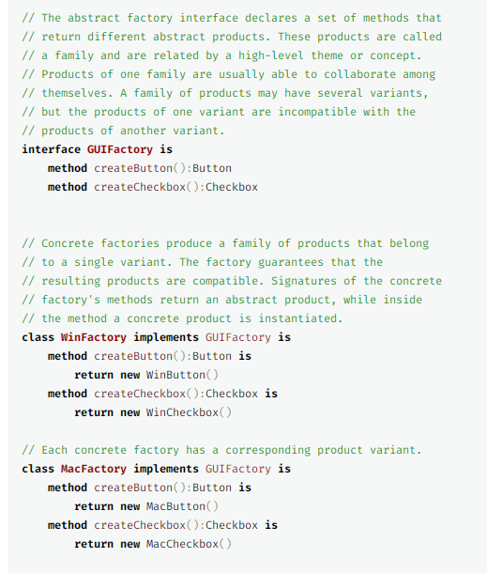
Pseudocode

Slide 25
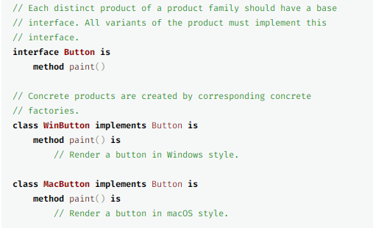
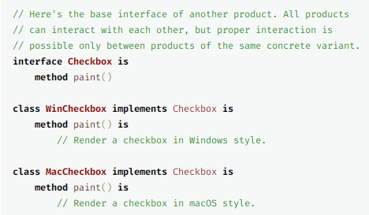
Pseudocode

Slide 26
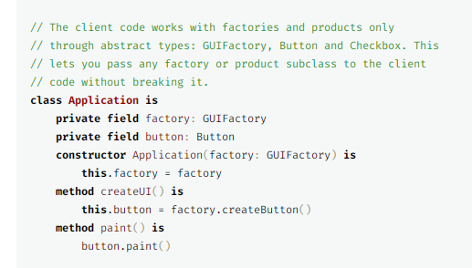
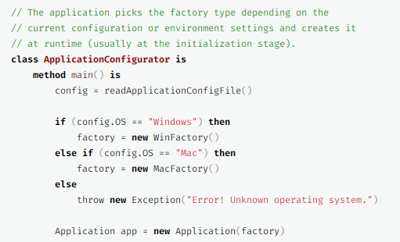
Pseudocode

Slide 27
Applicability
Use the Abstract Factory when your code needs to work with various families of related products, but you don’t want it to depend on the concrete classes of those products—they might be unknown beforehand or you simply want to allow for future extensibility.
The Abstract Factory provides you with an interface for creating objects from each class of the product family. As long as your code creates objects via this interface, you don’t have to worry about creating the wrong variant of a product which doesn’t match the products already created by your app.

Slide 28
Applicability
Consider implementing the Abstract Factory when you have a class with a set of Factory Methods that blur its primary responsibility.
In a well-designed program each class is responsible only for one thing. When a class deals with multiple product types, it may be worth extracting its factory methods into a stand-alone factory class or a full-blown Abstract Factory implementation.

Slide 29
How to Implement
1. Map out a matrix of distinct product types versus variants of these products.
2. Declare abstract product interfaces for all product types. Then make all concrete product classes implement these interfaces.
3 . Declare the abstract factory interface with a set of creation methods for all abstract products.
4. Implement a set of concrete factory classes, one for each product variant.

Slide 30
How to Implement
5. Create factory initialization code somewhere in the app. It should instantiate one of the concrete factory classes, depending on the application configuration or the current environment. Pass this factory object to all classes that construct products.
6 . Scan through the code and find all direct calls to product constructors. Replace them with calls to the appropriate creation method on the factory object.

Slide 31
Pros and Cons
Pros：
1. You can be sure that the products you’re getting from a factory are compatible with each other.
2. You avoid tight coupling between concrete products and client code.
3.Single Responsibility Principle. You can extract the product creation code into one place, making the code easier to support.
4. Open/Closed Principle. You can introduce new variants of products without breaking existing client code.
Cons:
The code may become more complicated than it should be, since a lot of new interfaces and classes are introduced along with the pattern.

Slide 32
Relations with Other Patterns
1. Many designs start by using Factory Method (less complicated and more customizable via subclasses) and evolve toward Abstract Factory, Prototype, or Builder (more flexible, but more complicated).
2. Builder focuses on constructing complex objects step by step. Abstract Factory specializes in creating families of related objects. Abstract Factory returns the product immediately, whereas Builder lets you run some additional construction steps before fetching the product.

Slide 33
Relations with Other Patterns
3. Abstract Factory classes are often based on a set of Factory Methods, but you can also use Prototype to compose the methods on these classes.
4. Abstract Factory can serve as an alternative to Facade when you only want to hide the way the subsystem objects are created from the client code.

Slide 34
Relations with Other Patterns
5. You can use Abstract Factory along with Bridge. This pairing is useful when some abstractions defined by Bridge can only work with specific implementations. In this case, Abstract Factory can encapsulate these relations and hide the complexity from the client code.
6. Abstract Factories, Builders and Prototypes can all be implemented as Singletons.

Slide 35
Thank you！

